Slide 1
Shape of the cosmos
History of Maths and
where Gravity
A talk at the University of Nottingham by Peter Rowlett

Slide 2
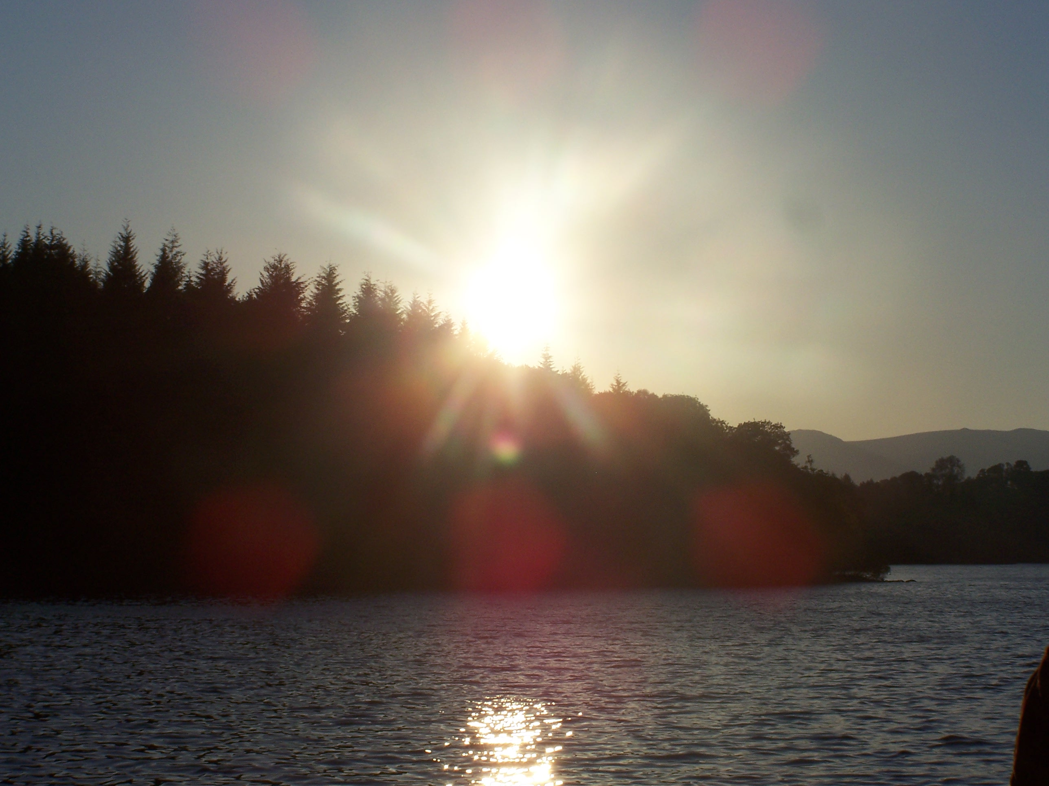
Notes:
Lake Windermere

Slide 3
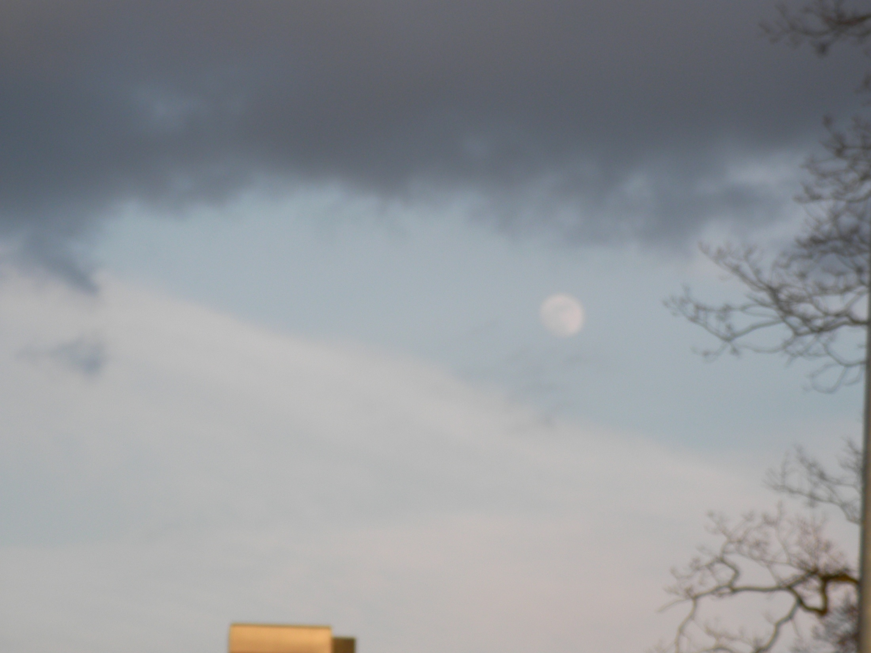
Notes:
Reading

Slide 4
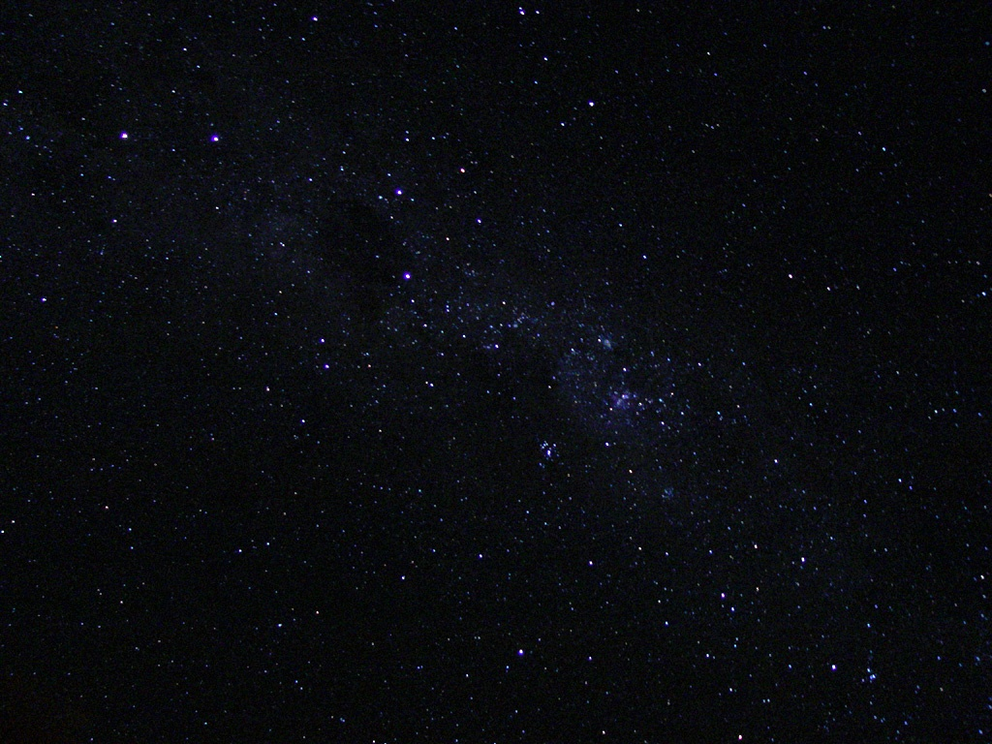

Slide 5
Watching the sky
You will have noticed the Sun and moon moving across the sky
Wait for long enough and you can see the stars shifting and nearby planets moving against the general background of stars

Slide 6
“Several billion trillion tons of superhot exploding hydrogen nuclei rose slowly above the horizon and managed to look small, cold and slightly damp.”
– Douglas Adams, Life, the universe and everything

Slide 7
Watching the sky
It is very intuitive to imagine that you are standing still and the objects you are observing are moving above you

Slide 8
Watching the sky
The movement of these bodies is useful in marking the passage of time and tracking the seasons - important for growing crops
Studying the locations of stars is useful for judging your location, which is vital for navigation

Slide 9
The Babylonians
4000 years ago
Skilled astronomical observers
Able to predict the apparent motion of celestial bodies
However, there is no indication they had a model for the structure that gave rise to such apparent motion.

Slide 10
The Greeks
Around 400BC, proposed a model which was developed over the following centuries, notably by Ptolemy, to become one that persisted from the 2nd Century AD for more than a thousand years

Slide 11
The Greeks
Had identified Earth as spherical, certainly by around 500BC
Since the Sun, Moon, planets and stars were moving through the Heavens, they were considered to be 'perfect' and so they were expected to orbit Earth in perfect circular motion

Slide 12
Geocentric
A model of celestial motion with Earth at the centre
"geo" is from a Greek word for Earth

Slide 13
Greek model
Viewing by naked eye, the stars appear to move as one, not shifting relative to each other as they appear to move across the sky
This early model fixed the stars on the inside of a giant sphere which contained the Heavens
Earth was motionless at the centre of the celestial sphere and orbited by the other known bodies, in the order: Moon, Mercury, Venus, Sun, Mars, Jupiter and Saturn

Slide 14
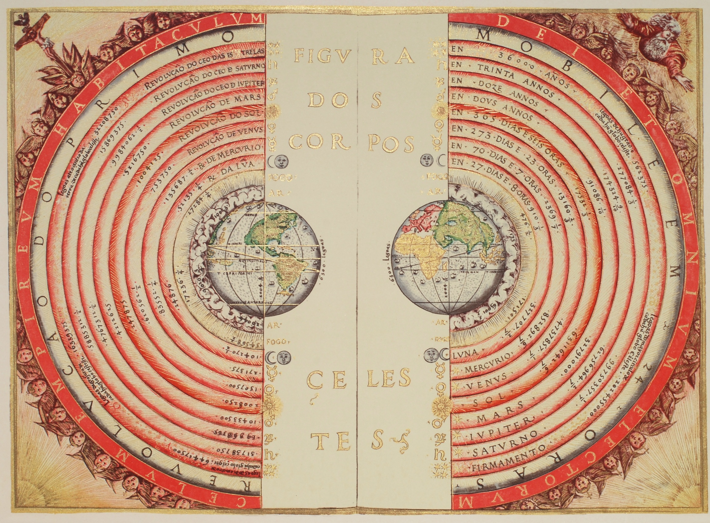
Notes:
Illustration of the Ptolemaic geocentric conception of the Universe by Portuguese cosmographer and cartographer Bartolomeu Velho (?-1568). From his work ''Cosmographia', made in France, 1568
http://commons.wikimedia.org/wiki/File:Bartolomeu_Velho_1568.jpg

Slide 15
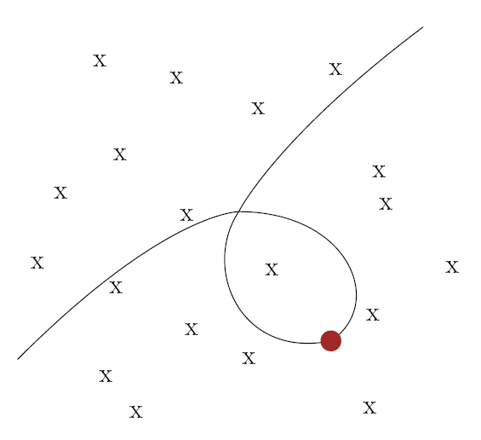
Motion of Mars against ‘fixed’ stars

Slide 16
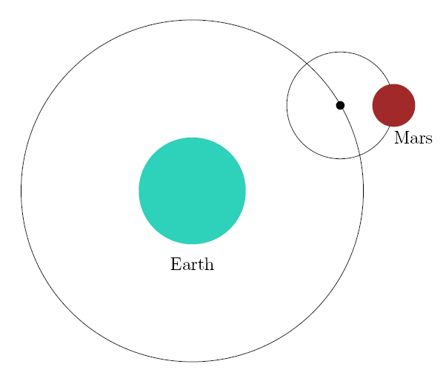
Epicycles
epicycle
deferent

Slide 17
Epicycles
As time passed, increasing numbers of epicycles were used to explain all of the observed variations in speed and direction of the apparent motion of the celestial bodies

Slide 18
Challenging the geocentric model
During the time this geocentric model was generally accepted, alternative models were proposed
Particularly in the ancient Greek, ancient Indian and medieval Islamic civilisations, alternatives were proposed, including those in which Earth moves or rotates on its own axis and those with the Sun at the centre of the universe

Slide 19
Heliocentric
Model with the Sun at the centre of the universe
From the Greek "helios" for Sun

Slide 20
A philosophical question
Astronomical observations could be made to fit different models
No mathematical explanation of why an alternative model might be preferred over the established one
Meanwhile, the Greek geocentric model was usefully predicting the movement of the heavenly bodies

Slide 21
Copernicus
At the end of his life in 1543, the capable astronomer Copernicus published a theory with the Sun at the centre of the universe and Earth and the planets orbiting the Sun
Still based on circular motion and so, like the Greek model, used numerous epicycles to make the model fit the observed data

Slide 22
The heliocentric model helps to explain some problems with a geocentric model, such as why Venus and Mercury are never seen very far from the Sun in the sky
In the Copernican model, this is because Venus and Mercury are between Earth and the Sun
Still, there were problems with this heliocentric model and no clear evidence to support either theory

Slide 23
Sizes of orbits
Using the Copernican model, a calculation could be made based on observations to give the sizes of the planetary orbits
This gave large gaps between the six planets, the reasons for which were not explained
In the late 16th Century, Kepler proposed a heliocentric model that attempted to explain why the planets were so spaced using regular polyhedra

Slide 24
Orbit of Saturn
Orbit of Jupiter
Orbit of Mars

Slide 25
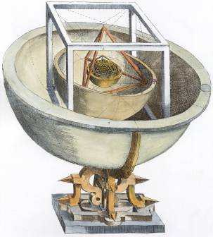
Kepler’s Platonic model
Notes:
Kepler's model of the planetary orbits as Platonic solids.
http://commons.wikimedia.org/wiki/File:Engraving_of_Kepler_s_Platonic_Universe.jpg

Slide 26
Kepler’s Platonic model
Gives an explanation for why there were at that time only 6 known planets; Euclid tells us there are precisely 5 Platonic solids
Also fit convincingly with the sizes of the orbits of the planets estimated using the Copernican model, with the greatest error being less than 10%

Slide 27
Tycho Brahe
Accomplished astronomer
Invented new instruments and made observations during the 16th Century more accurately than those recorded previously
Realised if Earth was orbiting the Sun, the relative positions of the fixed stars would change from different points in Earth's orbit, a phenomenon called parallax

Slide 28
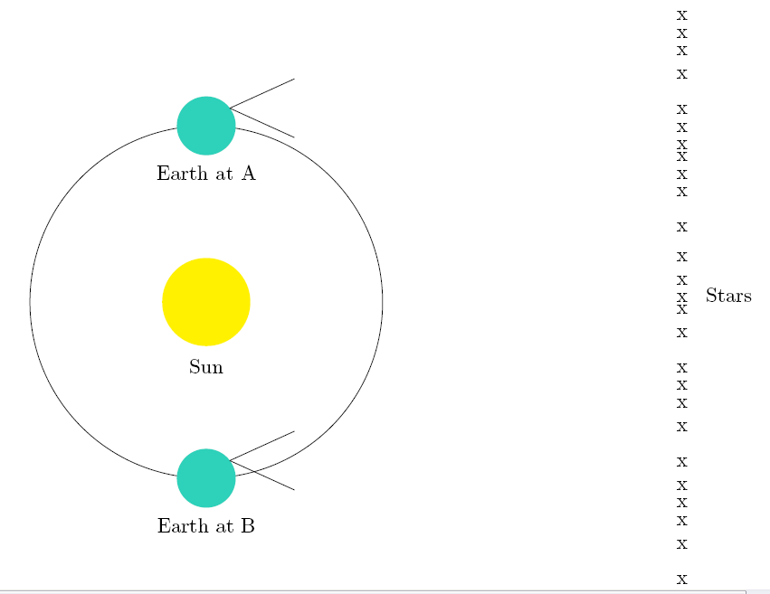
Parallax

Slide 29
Tycho’s model
Tycho’s observations did not detect a parallax
This could be explained if Earth was not moving, or if the stars were much further away than was generally thought at the time
Instead of a heliocentric model, Tycho proposed a system with the planets orbiting the Sun and the Sun, in turn, orbiting Earth

Slide 30
Galileo
One of the early users of a new technology, the telescope
Observed several moons orbiting Jupiter
celestial bodies not orbiting Earth
If Jupiter can have moons, might not at least some of the planets orbit the Sun?

Slide 31
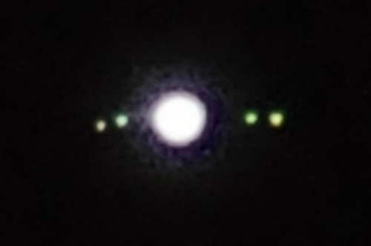

Slide 32
Galileo
Also published descriptions of the roughness of the moon's surface, and of sunspots on the surface of the Sun
If the Heavenly bodies were not perfect spheres, they might not move in perfect circles

Slide 33
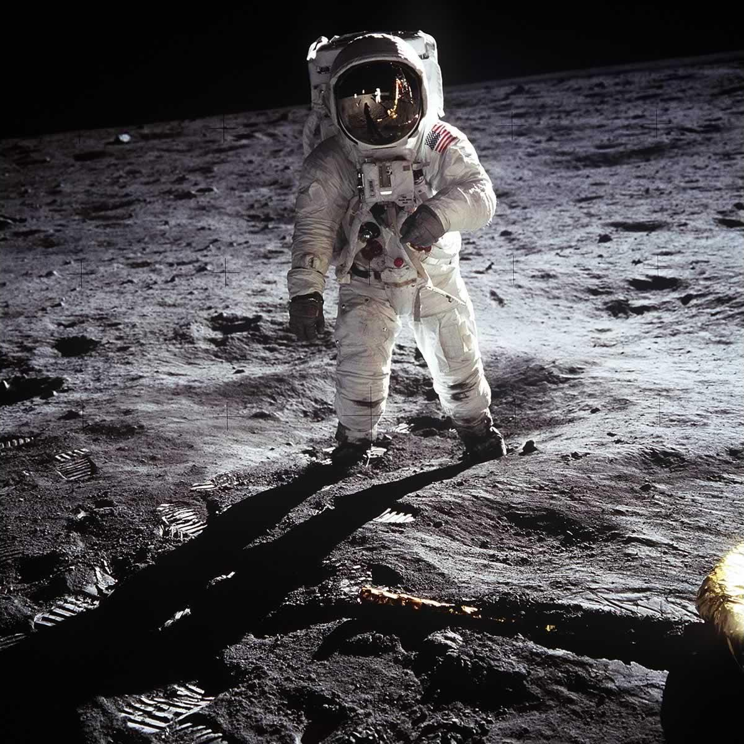
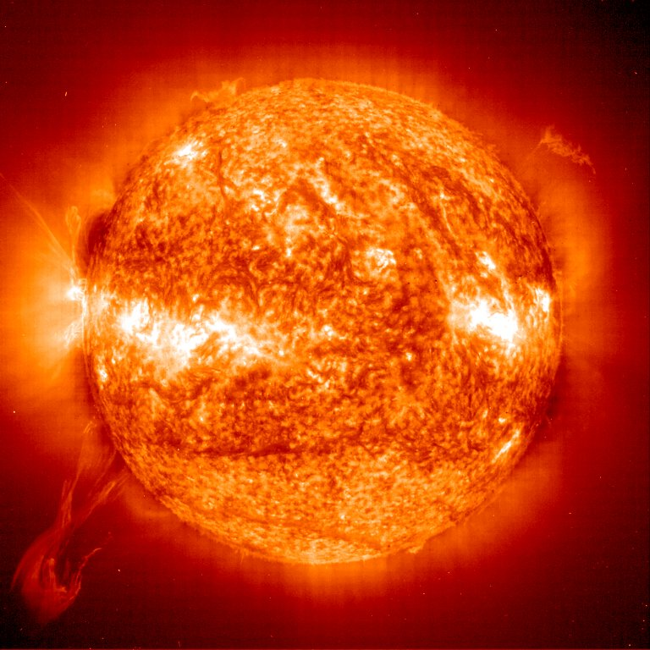

Slide 34
Tycho’s measurements
At the end of his life, Tycho Brahe was receiving mathematical assistance from Kepler
On Tycho's death in 1601, Kepler inherited his measurements
Kepler now had a large number of observations of the planets

Slide 35
Tycho’s measurements
Kepler attempted to use these measurements to provide evidence for a heliocentric model
Particularly important was the position of Mars, which we have seen to have an unusual movement across the sky

Slide 36
Motion of Mars against ‘fixed’ stars

Slide 37
Kepler’s model
Kepler's planetary orbits are not simply paths taken by planets but also have a second independent component, representing time
Both are described geometrically
He calculated that rather than a heliocentric model based on epicycles, the observations would fit very well if the planetary orbits were elliptical, with the Sun at one of the foci
Kepler produced a geometric proof of this model using Euclid's geometry

Slide 38
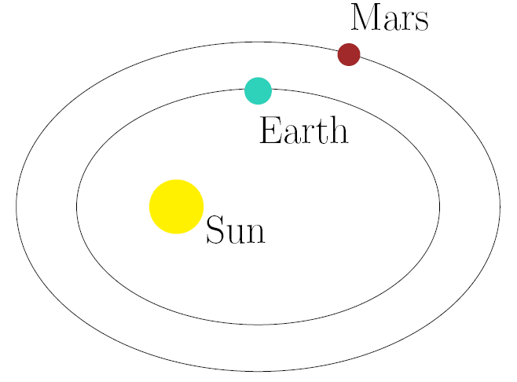

Slide 39
Kepler's 1st Law of Planetary Motion
The Ellipse Law - the orbit of a planet is an ellipse with the Sun at one focus of the ellipse
broke the tradition of planetary orbits being circular

Slide 40
Kepler's 2nd Law of Planetary Motion
The Equal-Areas Law – the radius drawn between the planet and the Sun sweeps out equal areas in equal periods of time as the planet travels around the Sun
recognised that the speed of a planet is not constant
planets move more quickly when they are in the part of their orbit closer to the Sun

Slide 41
Kepler's 3rd Law of Planetary Motion
The Harmonic Law - The square of the orbital period of a planet is directly proportional to the cube of the semi-major axis of its orbit
Since Mars and Earth both orbit the Sun, and Earth is closer, then Earth's orbital period is shorter than that of Mars
In fact, a Martian year is roughly twice that of an Earth year

Slide 42
Kepler's 3rd Law of Planetary Motion
The Harmonic Law - The square of the orbital period of a planet is directly proportional to the cube of the semi-major axis of its orbit
Because of the difference in the speed of their orbits, Earth sometimes catches up with and sometimes overtakes Mars
The two orbits are not quite in the same plane
These relative motions cause the apparent motion of Mars to appear erratic when viewed from Earth

Slide 43
Rudolphine Tables
Over the following years, Kepler was able to demonstrate that observations of all 6 known planets could fit orbits that were elliptical with the Sun at a focus
He used his theories to produce a set of astronomical predictions, the Rudolphine Tables (1627), which remained accurate for much longer than similar astronomical tables produced at the time

Slide 44
What causes celestial motion?
We have avoided this philosophical question
But the next part of this story relies on an explanation of this phenomenon

Slide 45
‘Action at a distance’
Aristotle says that objects do not move unless compelled to do so by an external force, and that force must act on contact between objects
This does not allow so-called ‘action at a distance’, forces that act without physical contact
Many models of celestial motion were proposed

Slide 46
Kepler’s model
The Sun rotates on its axis
Rays are emitted from the rotating Sun which push the planets around in their orbits
Planets that are further from the Sun are hit with less force and so the effect of the rays would weaken with distance

Slide 47
Descartes’ model
The cosmos is filled with particles of matter, called aether
Aether moves in a series of vortices
It is these vortices that cause the planets to move in their orbits

Slide 48
Which model is valid?
Many other models were proposed
Which model to adopt remained a matter for philosophy, since observations were not available to support a particular model and no experiment could be proposed to discover how celestial motion took place

Slide 49
Newton
A force, called gravity, acts between every pair of bodies in the universe
Connected the movement of the moon around Earth to the behaviour of objects near the Earth's surface, linking two phenomena:
the behaviour of a falling object when dropped
the motion of the celestial bodies around the cosmos
This model is called universal gravitation

Slide 50
Newton's law of universal gravitation
The force of attraction, F, exerted by two bodies on each other is proportional to their masses, m₁ and m₂, and inversely proportional to the square of the distance, d, between them

Slide 51
The moon
The moon is pulled towards Earth because Earth attracts it through gravity
Earth is attracted to the moon by an equal and opposite force, but this force has less observable effect on their relationship because the mass of Earth is much greater than that of the moon

Slide 52
Principia
Newton published his findings on astronomy in 1687 in his great work Philosophiae naturalis principia mathematica (known as ‘Principia’)

Slide 53
Principia
Newton shows
if planets are attracted to the Sun and the force of attraction acts as inverse square of the distance, Kepler's 2nd and 3rd Laws hold
an orbit caused by an inverse square law is a conic section (ellipse, parabola or hyperbola), which allows Kepler's 1st Law

Slide 54
Parallax
Tycho Brahe had shown the lack of a parallax of a star provided evidence of a fixed Earth, which Kepler and Newton's heliocentric models dispute
Parallax does occur, but is so small that it could not have been detected by Tycho's instruments

Slide 55
Parallax
The first recorded measurement of the parallax of a star was in 1838 by Bessel who found a parallax for a star called 61 Cygni
The parallax effect is smaller than expected because the stars are much further away than was thought in Tycho's time

Slide 56
Newtonian physics
There were those who did not accept Newton's model, which required action at a distance
But Newton's model predicted or explained all new discoveries in astronomy for over 200 years, after which it was ultimately replaced by a model based on Einstein's spacetime
Our current model for the cosmos has neither Earth nor the Sun at the centre of the universe but has Earth orbiting one of many suns in part of a wider galaxy, also one of many

Slide 57
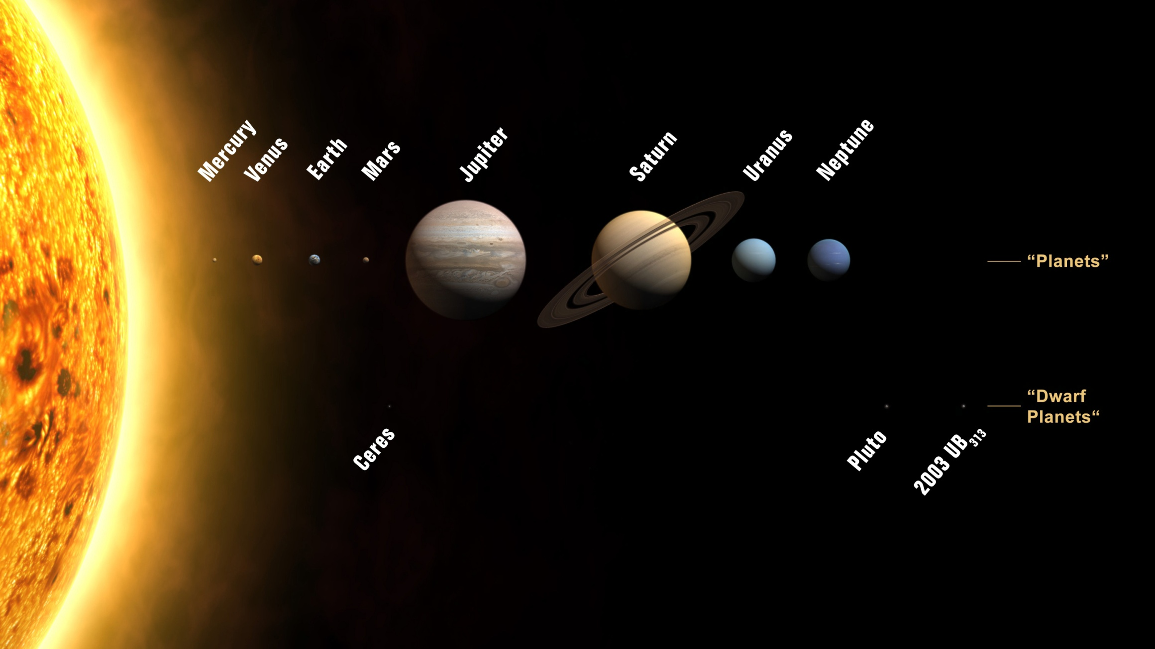

Slide 58
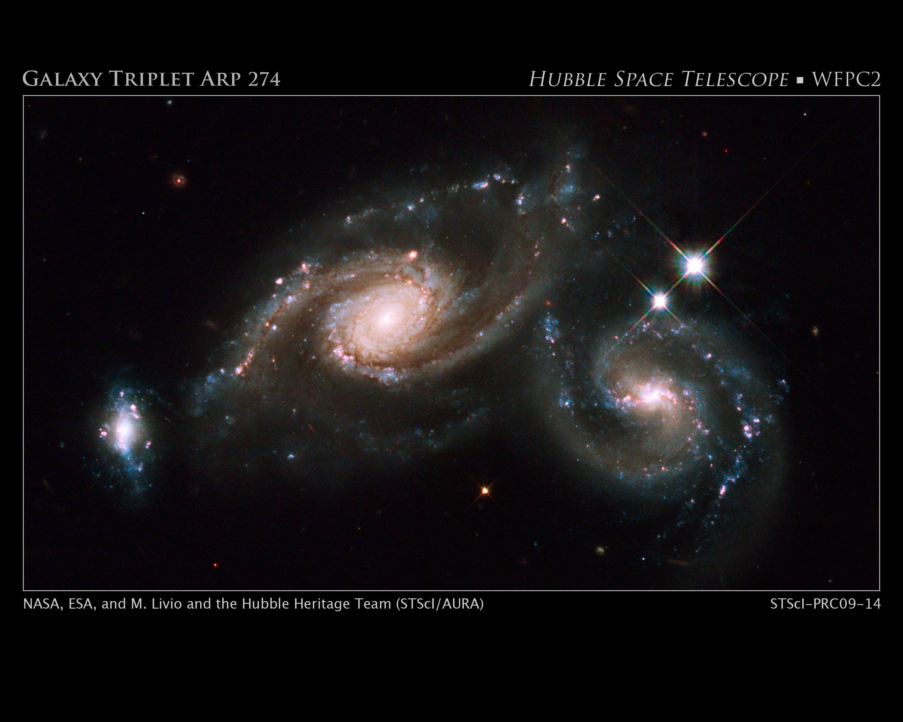

Slide 59
Einstein
If you would like to find out more about the limits of Newton's model and what Einstein says about the shape of the cosmos, you can listen to the companion podcast to this talk

Slide 60
Images
Space images in this presentation are from:
flickr.com/coda (Night sky)
flickr.com/dingopup (Jupiter and moons) www.nasaimages.org (Buzz Aldrin on the moon, sun spots, solar system, galaxy triplet)
“Engraving of Kepler’s Platonic Universe” and “Figure of the heavenly bodies” from Wikimedia Commons
Other pictures by Peter Rowlett

Slide 61
BSHM
If you are interested in mathematical histories then you might be interested in the work of The British Society for the History of Mathematics, whose home on the web is
www.bshm.org

Slide 62
History of Maths and
This talk is accompanied by an audio podcast and by an article in iSquared Magazine
You can find out how to get access to other aspects of the History of Maths and x output through the website:
www.historyofmathsandx.co.uk

